Slide 1
ChatGPT: How it Works
Sam Scott, Mohawk College, May 2023
https://www.youtube.com/@profsamscott

Slide 2
The Core Task of ChatGPT (Video 1)
Given a text prompt, predict the natural language token (word) that comes next.
ChatGPT is a Large Language Model powered by a deep Artificial Neural Network architecture called a Transformer.

Slide 3
What is a Language Model?
It’s a probability distribution for sequences of tokens (words)
“it’s my day in the sun” vs “my it’s sun day the in”
p = 90%
p = 0.1%
It can do conditional probabilities
“it’s my day in the…” → “sun”
“would you like to purchase the…” → “sun”
p = 53%
p = 5%

Slide 4
ChatGPT: One Token at a Time
 | Prompt | Output
1 | How are you today? | I

Slide 5
ChatGPT: One Token at a Time
 | Prompt | Output
1 | How are you today? | I
2 | How are you today? I | 'm

Slide 6
ChatGPT: One Token at a Time
 | Prompt | Output
1 | How are you today? | I
2 | How are you today? I | 'm
3 | How are you today? I’m | doing

Slide 7
ChatGPT: One Token at a Time
 | Prompt | Output
1 | How are you today? | I
2 | How are you today? I | 'm
3 | How are you today? I’m | doing
4 | How are you today? I’m doing | well

Slide 8
ChatGPT: One Token at a Time
 | Prompt | Output
1 | How are you today? | I
2 | How are you today? I | 'm
3 | How are you today? I’m | doing
4 | How are you today? I’m doing | well
5 | How are you today? I’m doing well | ,

Slide 9
ChatGPT: One Token at a Time
 | Prompt | Output
1 | How are you today? | I
2 | How are you today? I | 'm
3 | How are you today? I’m | doing
4 | How are you today? I’m doing | well
5 | How are you today? I’m doing well | ,
6 | How are you today? I’m doing well, | thanks

Slide 10
ChatGPT: One Token at a Time
 | Prompt | Output
1 | How are you today? | I
2 | How are you today? I | 'm
3 | How are you today? I’m | doing
4 | How are you today? I’m doing | well
5 | How are you today? I’m doing well | ,
6 | How are you today? I’m doing well, | thanks
7 | How are you today? I’m doing well, thanks | for

Slide 11
ChatGPT: One Token at a Time
 | Prompt | Output
1 | How are you today? | I
2 | How are you today? I | 'm
3 | How are you today? I’m | doing
4 | How are you today? I’m doing | well
5 | How are you today? I’m doing well | ,
6 | How are you today? I’m doing well, | thanks
7 | How are you today? I’m doing well, thanks | for
… | … | …

Slide 12
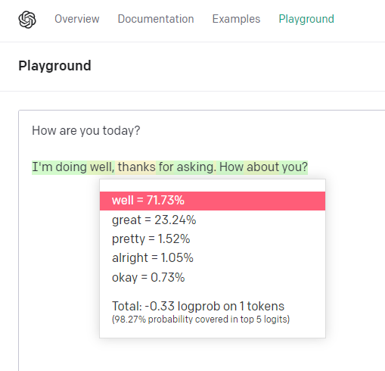
Try it Yourself!
platform.openai.com/playground
Mode: Complete
Show Probabilities: Full Spectrum
Enter a prompt
Press Submit.
Click a word…

Slide 13
A Tiny Language Model (TLM)
The TLM counts tokens (words) in a small dataset (62 MB of text)
Token | Count | Frequency (%)
. | 135 319 | 6.7%
I | 72 506 | 3.7%
the | 68 432 | 3.4%
and | 61 352 | 3.1%
that | 47 409 | 2.4%

Slide 14
TLM 1: Roulette Selection, No Context
Those optimism I it doubt getting would we and? Are but you and so the. We have that cheering the yeah administrators find that thorn change there is even all're agree what.

Slide 15
TLM 2: One Word of Context
TLM 2 Counts bigrams (pairs of tokens)
* percentage of all “the ___” bigrams
bigram | Count | Frequency*
the same | 1102 | 1.7%
the other | 1031 | 1.6%
the time | 854 | 1.3%
the way | 811 | 1.2%
the people | 709 | 1.1%

Slide 16
TLM 2: One Word Context
Prompt: I
Context: "I" …
have been to be an interesting. The one of the only the same time with them. They don't get up the time I'm going to be some of people.

Slide 17
TLM 2: One Word Context
Prompt: hello!
Context: ‘!’ …
The whole lot. The first year. The same problem. In the last two years ago the same thing. The people who had a lot of a good.

Slide 18
TLM 3: Two Word Context (trigrams)
Prompt: Tell me something interesting.
Context: 'interesting .’ …
Oh I know that's a big change. There is a little bit more. It has been the way it should be a little bit of money.

Slide 19
TLM 4: Three Word Context (4-grams)
Prompt: Tell me something interesting.
Context: 'something interesting .' ...
One possible solution is a quite radical one. Say if each household in britain was only allowed 1 car or each registered voter was allowed the volume would be immediately privileged in such a situation exhibits unfailing resolve and determination.

Slide 20
From Tiny to Large Language Models
LLMs are massively scaled up
GPT-3
570 GB (499 Billion tokens) of training text
$12 million to train
Predictions based on 2048-grams
GPT-4
Training data and costs undisclosed
Predictions based on 8192-grams or 32768-grams

Slide 21
From Tiny to Large Language Models
The TLM approach does not scale up
Storage
28 000 tokens, 350 000 bigrams, 880 000 trigrams, 1.2 million 4-grams….
How many 2048-grams?
Sparsity
The longer the sequence, the rarer it is.
“The big green” → 1 occurrence in the TLM corpus
“The big red” and “the big blue” aren’t there at all…
Large Language Models must generalize!

Slide 22
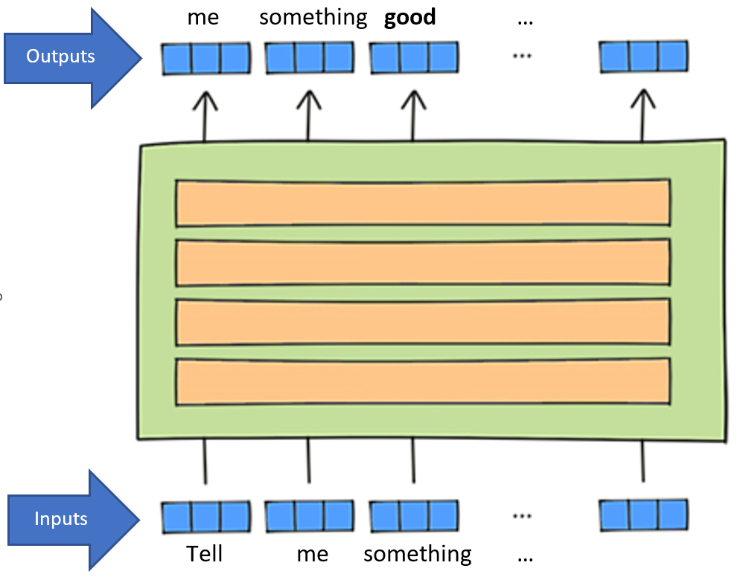
A 1000-foot View of an LLM (Video 2)
Tokens are converted to vectors (lists of numbers)
All the tokens are fed in at the same time.
2048 x 50000 = 102 400 000 inputs & outputs
Artificial Neural Networks
(mostly)
Adapted from https://www.lavivienpost.com/how-chatgpt-works-architecture-illustrated/

Slide 23
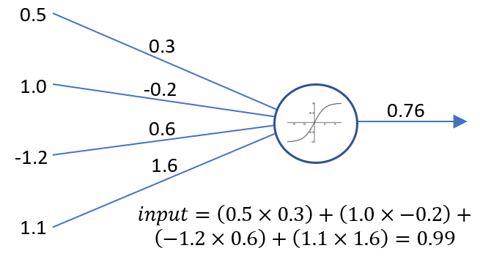
What is an Artificial Neural Network?
It’s a bunch of simple calculation devices (artificial neurons) all hooked up together.
It’s a way of turning one set of numbers into another set of numbers.
Here’s an artificial neuron
output
inputs
weights
activation function
Input = 0.5 x 0.3 + 1.0 x (-0.2) + (-1.2) x 0.6
+ 1.1 x 1.6 = 0.99

Slide 24
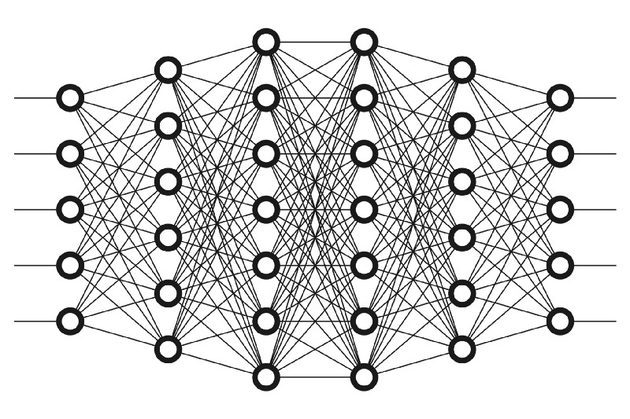
What is an Artificial Neural Network?
It’s a bunch of simple calculation devices (artificial neurons) all hooked up together.
It’s a way of turning one set of numbers into another set of numbers.
Here’s an artificial neural network
Weights = Parameters (175 Billion)
Learning = Adjusting Parameters
inputs
outputs
weights
weights
https://www.freecodecamp.org/

Slide 25
The 1000-foot View Again
Tokens are converted to vectors (lists of numbers)
All the tokens are fed in at the same time.
2048 x 50000 = 102 400 000 inputs & outputs
Artificial Neural Networks
(mostly)
Adapted from https://www.lavivienpost.com/how-chatgpt-works-architecture-illustrated/

Slide 26
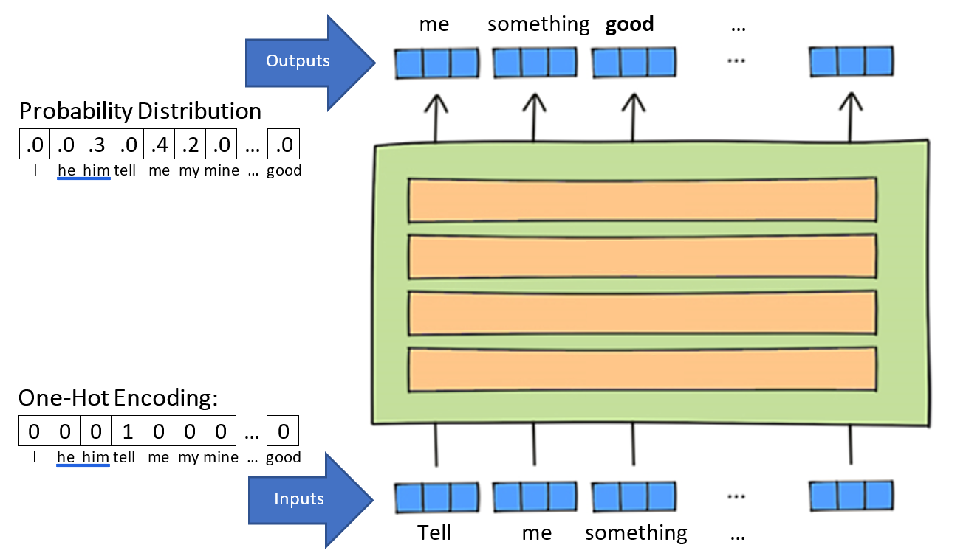
The 1000-foot View Again
Artificial Neural Networks
(mostly)
Adapted from https://www.lavivienpost.com/how-chatgpt-works-architecture-illustrated/

Slide 27
The 1000-foot View Again
Input: 0 0 1 0 0 …. 0
Embeddings (c. 2002) are information-rich lists of numbers.
Attention modifies embeddings using the previous tokens.
Reverse Embedding tries to turn the result back into 0 0 0 0 1 … 0.
…But we end up with a probability distribution instead.
The process is messy.
There is no single best word.
Reverse Embedding
Attention
Positional Encoding
Embedding
Adapted from https://www.lavivienpost.com/how-chatgpt-works-architecture-illustrated/

Slide 28
What We Know and Don’t Know
ChatGPT is predicting the next token based on a generalized context.
It’s processes thousands of words in parallel.
Tokens are represented as vectors of numbers.
Each vector gets transformed into a prediction.
Sometimes ChatGPT “hallucinates”. Can this be solved?
Is ChatGPT thinking or reasoning?
🤷
What would William of Okham say?

Slide 29
From Base Models to ChatGPT
The “base models” (c. 2020-2021) are both amazing and also not very good.
Try this: davinci
How did we get from there to ChatGPT?
Size of data sets helps a little
Training
Prompt engineering

Slide 30

Training Methods for ChatGPT (Video 3)
Reward
Modelling
Supervised
Fine Tuning
Base Model
Training
RLHF
Reinforcement
Learning
ChatGPT

Slide 31
Base Model Training
Typical Scope | Human Involvement | Base Models
A trillion tokens, 1000 GPUs, many months | None | davinci, curie, babbage, ada
The Study Archive file format is a data compression and archive format, based directly on the ZIP file format.[1] Study archives are intended for the development and use of sets of interactive flashcards, which may contain not only text but also images and audio files, in various applications.
The Study Archive file format is a data compression and archive format, based directly on the ZIP file format.[1] Study archives are intended for the development and use of sets of interactive flashcards, which may contain not only text but also images and audio files, in various applications.
The Study Archive file format is a data compression and archive format, based directly on the ZIP file format.[1] Study archives are intended for the development and use of sets of interactive flashcards, which may contain not only text but also images and audio files, in various applications.
The Study Archive file format is a data compression and archive format, based directly on the ZIP file format.[1] Study archives are intended for the development and use of sets of interactive flashcards, which may contain not only text but also images and audio files, in various applications.
used
Input
WRONG!
Target output
System is gently nudged in the right direction.

Slide 32
Supervised Fine Tuning
Typical Scope | Human Involvement | SFT Models
100 000 prompts and responses, 100 GPUs, one month | Prompts with responses | davinci-instruct-beta
Prompt: Can you give me some suggestions for classic 90's rock songs I would like? I'm a big fan of Nirvana and Pearl Jam but I know all their songs already.
Response: 1. Soundgarden – Rusty Cage, 2. Radiohead – Creep, 3. Smashing Pumpkins – 1979
Prompt: Hi, how are you today?
Response: As an AI, I do not have feelings or emotions, but I am here to help you. How can I assist you today?

Slide 33
Supervised Fine Tuning
Typical Scope | Human Involvement | SFT Models
100 000 prompts and responses, 100 GPUs, one month | Prompts with responses | davinci-instruct-beta
Prompt: Can you give me some suggestions for classic 90's rock songs I would like? I'm a big fan of Nirvana and Pearl Jam but I know all their songs already.
Response: 1. Soundgarden – Rusty Cage, 2. Radiohead – Creep, 3. Smashing Pumpkins – 1979

Slide 34
Supervised Fine Tuning
Typical Scope | Human Involvement | SFT Models
100 000 prompts and responses, 100 GPUs, one month | Prompts with responses | davinci-instruct-beta
Prompt: Can you give me some suggestions for classic 90's rock songs I would like? I'm a big fan of Nirvana and Pearl Jam but I know all their songs already.
Response: 1. Soundgarden – Rusty Cage, 2. Radiohead – Creep, 3. Smashing Pumpkins – 1979
Nirvana
Input
WRONG!
Target output
System is gently nudged in the right direction.

Slide 35
Reward Modelling
Typical Scope | Human Involvement | Reward Models
A million response ratings, 100 GPUs, one month | Response ratings | N.A.
Prompt: Can you give me some suggestions for classic 90's rock songs I would like? I'm a big fan of Nirvana and Pearl Jam but I know all their songs already.
Response: 1. Nirvana – Drain You, 2. Pearl Jam – Jeremy, 3. Smashing Pumpkins – 1979 <|end|> <|-0.2|>
Prompt: Hi, how are you today?
Response: As an AI, I do not have feelings or emotions, but I am here to help you. How can I assist you today? <|end|> <|1.0|>
End
Reward
End
Reward

Slide 36
Reward Modelling
Typical Scope | Human Involvement | Reward Models
A million response ratings, 100 GPUs, one month | Response ratings | N.A.
Prompt: Can you give me some suggestions for classic 90's rock songs I would like? I'm a big fan of Nirvana and Pearl Jam but I know all their songs already.
Response: 1. Nirvana – Drain You, 2. Pearl Jam – Jeremy, 3. Smashing Pumpkins – 1979 <|end|> <|-0.2|>
Prompt: Hi, how are you today?
Response: As an AI, I do not have feelings or emotions, but I am here to help you. How can I assist you today? <|end|> <|1.0|>
Input
Target output

Slide 37
Reward Modelling
Typical Scope | Human Involvement | Reward Models
A million response ratings, 100 GPUs, one month | Response ratings | N.A.
Prompt: Can you give me some suggestions for classic 90's rock songs I would like? I'm a big fan of Nirvana and Pearl Jam but I know all their songs already.
Response: 1. Nirvana – Drain You, 2. Pearl Jam – Jeremy, 3. Smashing Pumpkins – 1979 <|end|> <|-0.2|>
Prompt: Hi, how are you today?
Response: As an AI, I do not have feelings or emotions, but I am here to help you. How can I assist you today? <|end|> <|1.0|>
Input
Target output

Slide 38
Reinforcement Learning
Typical Scope | Human Involvement | RLHF Models
30 000 prompts, 100 GPUs, one month | Prompts | text-davinci-003, ChatGPT
Prompt: Can you give me some suggestions for classic 90's rock songs I would like? I'm a big fan of Nirvana and Pearl Jam but I know all their songs already.
Response: 1. Nirvana – Drain You, 2. Pearl Jam – Jeremy, 3. Smashing Pumpkins – 1979 <|end|>
Reward Model: -0.4
System is nudged away from producing these tokens.

Slide 39
Reinforcement Learning
Typical Scope | Human Involvement | RLHF Models
30 000 prompts, 100 GPUs, one month | Prompts | text-davinci-003, ChatGPT
Prompt: Hi, how are you today?
Response: As an AI, I do not have feelings or emotions, but I am here to help you. How can I assist you today? <|end|>
Reward Model: 1.3
System is nudged towards producing these tokens.

Slide 40
Training Methods Recap
Type |  | Scope | Humans
Base Model Training |  | 1 000 000 000 000 tokens, 1000 GPUs, months of training | None
Supervised Fine Tuning |  | 100 000 prompts and responses, 100 GPUs, weeks of training | Prompt and response generation
R L H F | Reward Modelling | 1 000 000 response ratings, 100 GPUs, weeks of training | Response ratings
 | Reinforcement Learning | 30 000 prompts, 100 GPUs, weeks of training | Prompt generation

Slide 41
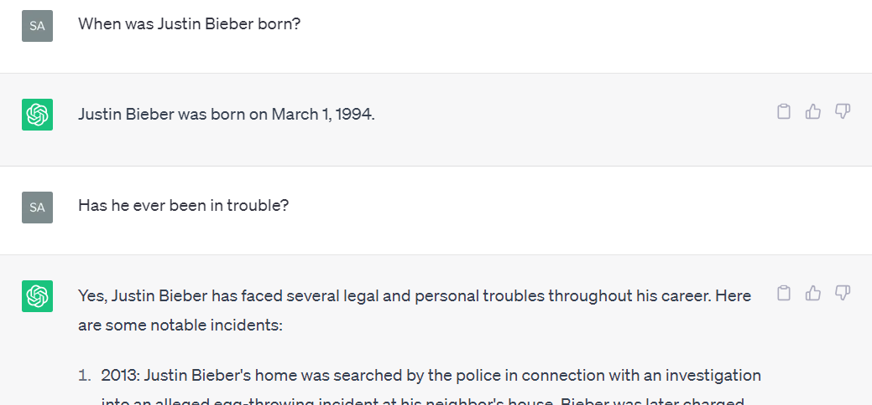
From Completion to Chat
Who is “he”?
It remembered!
ChatGPT acts like a helpful assistant…
SFT and RLHF training accounts for much of it
Prompt constraints: “User: ___, Assistant: ____”
A “system” message
ChatGPT also seems to track the conversation
Prompt Engineering

Slide 42
Can we trust ChatGPT? Two facts and an opinion.
Is it moderated by humans?
Fact: No it is not. Humans are involved in its training but it’s autonomous.
Does it memorize true information or have some kind of database?
Fact: No database lookups. You could perhaps argue that it “memorizes” things it sees a lot, but this memorization is far from perfect. (examples)
Is it ok to cite ChatGPT as a source?
Opinion: No way!!!
There’s no author
There’s no built-in drive to tell the truth
The “hallucination” problem is not going to go away

Slide 43
Thanks!
More detailed version of this presentations:
https://www.youtube.com/@profsamscott

